Slide 1
IoT Introduction

Slide 2
IoT Course Overview
What is IoT?
IoT Example
When was IoT Created?
IoT Privacy Concerns

Slide 3

Skills & expertise
Internet of Things (IoT) is internet connectivity and your devices connected to a cloud.
TVs - stream programs
Doorbells - cameras & audio
Cell Phones - weather check

Slide 4
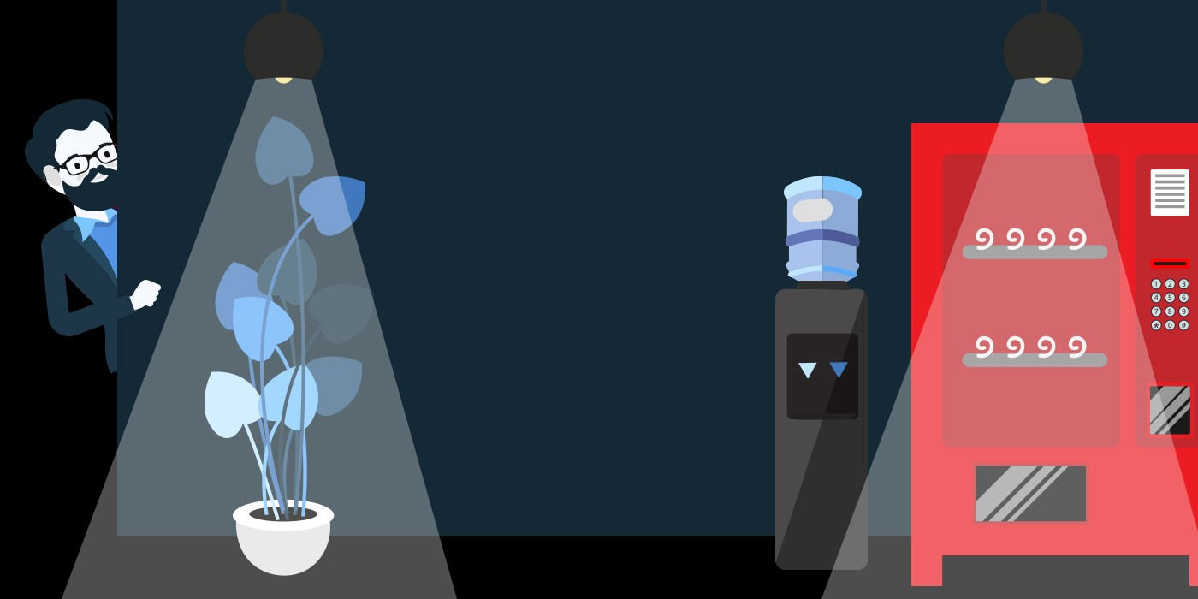
Skills & expertise
IoT was first created in the 1980s.
A coke machine
A graduate student
A need for cold coke

Slide 5
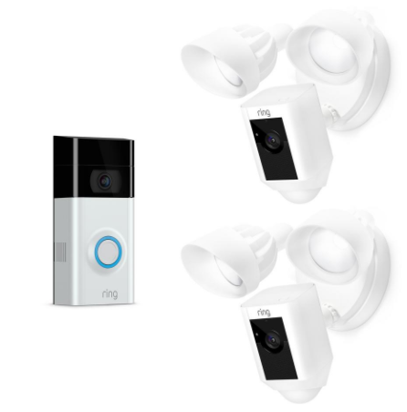
Skills & expertise
IoT is already in many homes using routers, door bells, and security cameras.
An example –
IoT connected doorbell
  Talk to someone
  Record the video
  Store in the cloud

Slide 6
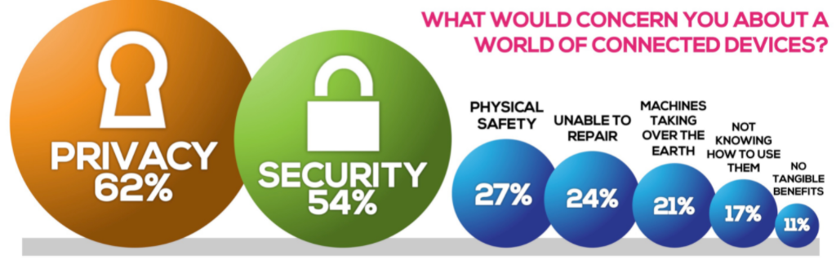
Skills & expertise
IoT privacy is a concern though.
Data from photos, family records, medical files, and more stored offsite
Connected devices in the home should be known like cell phones, TVs, and more

Slide 7

Congratulations
You have completed the first lesson in this course.
Are you ready for the next lesson?
If no, you will pick back up where you left off.
If yes, let’s warm up for the next lesson.

Slide 8
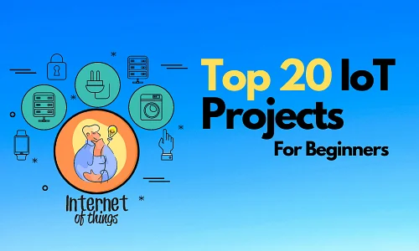
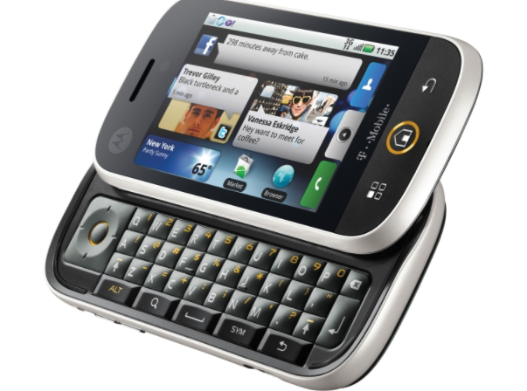

Sample IoT Project
We will explore the world of IoT projects with you as a beginner.
There is no better way to fully understand IoT than to create your own solution.
The project is optional and is not required to complete the course.

Slide 9

Hi, I’m Kevin Love
An innovative, passionate, and experienced IT professional with a strong track record of building relationships, managing projects from concept to completion, designing training, single-sourcing software documentation for reuse, and organizational development programs (in person, virtual, and online) to leverage business operations to enhance performance for customers in the IoT space.

